Slide 1

HDFS

Slide 2
Zookeeper
Zookeeper
Master
NameNode
Slave
DataNode
Slave
DataNode
Slave
DataNode
Zookeeper Ensue at any point of time all the slave machines are reporting to master machine.

Slide 3
High Availability
Edit Log
Master
NameNode
Back up Machine
Standby NameNode
Zookeeper
RAM
Metadata
Hot Back up
FS Image
FS Image
High Availability (HA)
:

Slide 4
Increase RAM of the Master Machine
Metadata
Machine Node
Machine Node
Machine Node
Machine Node
Are you able to procced if the master RAM is full so there will be no room for Metadata. You might be able to increase the ram to address it .Can we keep increasing it ? (vertical scaling issue)

Slide 5
Solution for this issue ?(Increase RAM of the Master Machine)
Virtual stock
Metadata
Metadata
Machine Node
Machine Node
Machine Node
Machine Node
Federation (Hadoop Gen 2)
Add another Master .These two machines are master.(apply the horizontal scaling ).These two machine is going to behave a single machine. They only maintain some Metadata

Slide 6
Hadoop Installation
1.Fully Distributed Mode
Whatever we covered so far
Replication:3
2.Psedo distributed Mode
One single machine (Master)
NameNode
Datanode
HDFS
Replication:1

Slide 7
Write Anatomy
Write Anatomy
Hdfs dfs –put Localfilesystempath HDFSpath
Machine
Node
Master
NameNode
Batch /abc.txt
B1,B2,B3
B1:3,2,6
B2:4,5,7
B3:11,21,9
ABC.txt
300 MB
B1
Base of rack awareness
Why is 3,2,6 ? Why is not 2,6,3 ?
B2
B3
Notes:
Write Anatomy means It is all about putting the data in to the HDFS.
Your first point of contact will be your master

Slide 8
Rack Awareness
R1N1
R2N5
B1
B1
Abc.txt
300MB
B2
B1
B1
B2
B3
B2
B3
Logged On
B3
B2
Data Blocks
Block size :128
B3
R3N12
3 Rack 12 Node cluster
We always select the machine which is closest to the machine which we logged on.(We logged on R2N6)

Slide 9
Sequence
R1N1
R2N5
B1
B1
Abc.txt
300MB
3
2
B2
B1
B1
B2
B3
B2
1
B3
Logged On
B3
B2
Data Blocks
Block size :128
B3
R3N12
Logged on R2N6
We always select the machine which is closest to the machine which we logged on.(We logged on R2N6)
On what base the selection of machine is done ? based on space availability and Rack awareness .
Sequence is decided based on proximity with respect to the machine you logged on .

Slide 10
Write Anatomy
Three process are running on the machine which you logged on
Data Queue
Data Streamer
Acknowledgement queue
We are only talking about B1
Write Anatomy
Hdfs dfs –put Localfilesystempath HDFSpath
Machine
Node
MASTER
NameNode
Batch /abc.txt
B1,B2,B3
B1:3,2,6
B2:4,5,7
B3:11,21,9
B1
ABC.txt
300 MB
B1
DQ
M3
M2
M6
B2
DS
B3
AQ

Slide 11
Write Anatomy
B1 IS 128 MB and its divided to 16 MB so 8 section.those packet (P1,P2,P3,P4,P5,P6,P7,P8) ARE part of DQ
Write Anatomy
Hdfs dfs –put Localfilesystempath HDFSpath
Machine
Node
MASTER
NameNode
Batch /abc.txt
B1,B2,B3
B1:3,2,6
B2:4,5,7
B3:11,21,9
B1
ABC.txt
300 MB
B1
DQ
M3
M2
M6
B2
DS
B3
AQ
Notes:
Data Queue
Data Streamer
Acknowledgement queue

Slide 12
Write Anatomy
Data Streamer will get meta data from B1 and write it to Machine 3
DS will take P1 and put it in AQ
DS will keep in touch with M3 and create a file there (in the Local file system ) and name it as B1then it writes this packet P1 on this
Write Anatomy
Hdfs dfs –put Localfilesystempath HDFSpath
Machine
Node
MASTER
NameNode
Batch /abc.txt
B1,B2,B3
B1:3,2,6
B2:4,5,7
B3:11,21,9
B1
P1
p6
ABC.txt
300 MB
B1
DQ
M3
M2
M6
B1
B2
DS
B3
(AQ)P1
Notes:
Data Queue
Data Streamer
Acknowledgement queue

Slide 13
After the packet is written the Machine number 3 will keep in touch with Machine number 2
And it will do the same thing and put packet P1 there
Now M2 will contact M6 and create a file there and put P1 there.
Write Anatomy
Hdfs dfs –put Localfilesystempath HDFSpath
Machine
Node
MASTER
NameNode
Batch /abc.txt
B1,B2,B3
B1:3,2,6
B2:4,5,7
B3:11,21,9
B1
P1
p6
ABC.txt
300 MB
B1
DQ
M3
M2
M6
B1
B1
B1
B2
DS
B3
(AQ)P1

Slide 14

After this is done .M6 will response back to M2 and says I am done with it
M2 will reply back to M3
Then M3 will response to DS and confirm P1 has successfully written in all machines
Write Anatomy
Hdfs dfs –put Localfilesystempath HDFSpath
Machine
Node
MASTER
NameNode
Batch /abc.txt
B1,B2,B3
B1:3,2,6
B2:4,5,7
B3:11,21,9
B1
P1
p6
ABC.txt
300 MB
B1
DQ
M3
M2
M6
B1
B1
B1
B2
DS
B3
(AQ)P1

Slide 15
After DS receive acknowledgement it will delete p1 from AQ and put p2 and do the same procedure
Write Anatomy
Hdfs dfs –put Localfilesystempath HDFSpath
Machine
Node
MASTER
NameNode
Batch /abc.txt
B1,B2,B3
B1:3,2,6
B2:4,5,7
B3:11,21,9
B1
P1
p6
ABC.txt
300 MB
B1
DQ
M3
M2
M6
B1(p2)
B1
B1
B2
DS
B3
(AQ)P2

Slide 16
After DS receive acknowledgement it will delete p2 from AQ and put p3 and do the same procedure
Write Anatomy
Hdfs dfs –put Localfilesystempath HDFSpath
Machine
Node
MASTER
NameNode
Batch /abc.txt
B1,B2,B3
B1:3,2,6
B2:4,5,7
B3:11,21,9
B1
P1
p6
ABC.txt
300 MB
B1
DQ
M3
M2
M6
B1(p3)
B1
B1
B2
DS
B3
(AQ)P3

Slide 17
After DS receive acknowledgement it will delete p7 from AQ and put p8 and do the same procedure
DS will receive ack For P8 so DS will contact NameNode and confirimB1 has been written successfully .I have written the data based on this Meta DATA
Write Anatomy
Hdfs dfs –put Localfilesystempath HDFSpath
Machine
Node
MASTER
NameNode
Batch /abc.txt
B1,B2,B3
B1:3,2,6
B2:4,5,7
B3:11,21,9
B1
P1
p6
ABC.txt
300 MB
B1
DQ
M3
M2
M6
B1(p8)
B1
B1
B2
DS
B3
(AQ)P8

Slide 18
Same Operation for B2
Write Anatomy
Hdfs dfs –put Localfilesystempath HDFSpath
Machine
Node
MASTER
NameNode
Batch /abc.txt
B1,B2,B3
B1:3,2,6
B2:4,5,7
B3:11,21,9
B2
P1
p6
ABC.txt
300 MB
B1
DQ
M4
M5
M7
B 2
B2
B2
B2
DS
B3
(AQ)P(1-8)

Slide 19
Same Operation for B3
Remember all operation happens simultaneously
B1,B2,B3 : are written in parallel
B1,B2,B3 :Parallel
B1:p1,P2,…P8 :Sequence
Write Anatomy
Hdfs dfs –put Localfilesystempath HDFSpath
Batch /abc.txt
B1,B2,B3
B1:3,2,6
B2:4,5,7
B3:11,21,9
Machine
Node
MASTER
NameNode
B3
P1
p6
ABC.txt
300 MB
B1
DQ
M11
M21
M9
B 3
B3
B3
B2
DS
B3
(AQ)P(1-8)

Slide 20
Failure
The procedure was successful so far but we do have the commodity HW so any time the failure may happen so we need to talk about this scenario .Assume P1 P2 is done and we are working on P3.So M2 will fail so AKW 8 will not received
So M3 will come to know that packet write operation to M2 failed .Same communication will be sent to DS.
Write Anatomy
Hdfs dfs –put Localfilesystempath HDFSpath
Machine
Node
MASTER
NameNode
Batch /abc.txt
B1,B2,B3
B1:3,2,6
B2:4,5,7
B3:11,21,9
B1
P1
p6
ABC.txt
300 MB
B1
DQ
M3
M2
M6
B1(p3)
B1
B1
B2
DS
B3
(AQ)P3
Notes:
https://www.youtube.com/watch?v=7sxqHgBdxB8

Slide 21
DS will take P3 and put it back in DQ and it will contact Master NameNode and Tell NameNode that B1 has been failed in M2 .NameNode will change the name of the block (B11) and please continue to write to other machine 3 and 6.This information will be sent to DS
Does NameNode has any information about packet ?No ,It has information about BLOCKS
DS will take P3 and Put it back in the AQ and it will communicate with M3
Write Anatomy
Hdfs dfs –put Localfilesystempath HDFSpath
Machine
Node
MASTER
NameNode
Batch /abc.txt
B1,B2,B3
B11:3,6
B2:4,5,7
B3:11,21,9
B1
P1
p6
ABC.txt
300 MB
B1
DQ (P3)
M3
M2
M6
B1
B1
B1
B2
DS
B3
(AQ)P3

Slide 22
DS will take P3 and Put it back in the AQ and it will communicate with M3 and it will change the name of the file to B11 then m3 will communicate to M6 directly and change the file to B11 and write the packet P3 there then M6 will confirm it directly to M3
M3 will contact DS and DS will delete P3 and Put P4 and do the same procedure
Write Anatomy
Hdfs dfs –put Localfilesystempath HDFSpath
Machine
Node
MASTER
NameNode
Batch /abc.txt
B1,B2,B3
B11:3,6
B2:4,5,7
B3:11,21,9
B1
P1
p6
ABC.txt
300 MB
B1
DQ (P3)
M3
M2
M6
B11
B1
B11
B2
DS
B3
(AQ)P3
Notes:
Data Queue
Data Streamer
Acknowledgement queue

Slide 23
DS will delete P3 and Put P4 and do the same procedure
Write Anatomy
Hdfs dfs –put Localfilesystempath HDFSpath
Machine
Node
MASTER
NameNode
Batch /abc.txt
B1,B2,B3
B11:3,6
B2:4,5,7
B3:11,21,9
B1
P1
p6
ABC.txt
300 MB
B1
DQ (P4)
M3
M2
M6
B11
B1
B11
B2
DS
B3
(AQ)P4

Slide 24
After DS will get confirmation for P8 it will contact Master NameNode and says that the data is written successfully on M3 ,6 based on Meta data
Write Anatomy
Hdfs dfs –put Localfilesystempath HDFSpath
Machine
Node
MASTER
NameNode
Batch /abc.txt
B1,B2,B3
B11:3,,6
B2:4,5,7
B3:11,21,9
B1
P1
p6
ABC.txt
300 MB
B1
DQ (P4)
M3
M2
M6
B11
B1
B11
B2
DS
B3
(AQ)P8

Slide 25
If M6 also fails (While you are writing P7) it will be the same scenario .NamaeNode will change the B11 to B12 and says DS to only write on M3.
Any of the write operation of any block can be successful if it is written successfully even in to one machine.
If all the three machines fails then the error will be displayed
Write Anatomy
Hdfs dfs –put Localfilesystempath HDFSpath
Machine
Node
MASTER
NameNode
Batch /abc.txt
B1,B2,B3
B12:3
B2:4,5,7
B3:11,21,9
B1
P1
p6
ABC.txt
300 MB
B1
DQ (P4)
M3
M2
M6
B12
B1
B11
B2
DS
B3
(AQ)P7

Slide 26
Questions
Under replication
Further machine fails
Why B1-B11
Corrupted block B1

Slide 27
Under replication Issue
There is HDFS balance in Master which come to know about B11 or M2,6 so it will contact to NameNode and ask for the third machine to make sure the replication factor remains to 3 so Name Node will says to load balance to save it to M78
Write Anatomy
Hdfs dfs –put Localfilesystempath HDFSpath
HDFS Balancer
Machine
Node
MASTER
NameNode
Batch /abc.txt
B11,B2,B3
B11:3,6 ,78
B2:4,5,7
B3:11,21,9
B1
P1
p6
ABC.txt
300 MB
B1
DQ (P4)
M3
M2
M6
B11
B1
B11
B2
DS
B3
(AQ)P7

Slide 28
M2 Back to production
When M2 is sending a heartbeat is fine however after 10 HB is sending the block report .This block report says that I have one block called B1 .HDFS Balance check with Meta Data and notice there is no information in MetaData regarding B1 so it seems either B1 is corrupted or half written block
HDFS Balance will go to M2 and Delete B1
Write Anatomy
Hdfs dfs –put Localfilesystempath HDFSpath
HDFS Balancer
Machine
Node
MASTER
NameNode
Batch /abc.txt
B11,B2,B3
B11:2,6 ,78
B2:4,5,7
B3:11,21,9
P1
p6
ABC.txt
300 MB
B1
DQ (P4)
M3
M2
M6
B11
B1
B11
B2
DS
B3
(AQ)P7

Slide 29
Why B1 –B11
Supposed you keep it B1.After M2 come back and sends information to DS then ds sends to Master .Then how HDFS Load Balance will know Bi is corrupted or not ?
It will know only when you change it to B11 otherwise it can not recognize it.
Write Anatomy
Hdfs dfs –put Localfilesystempath HDFSpath
HDFS Balancer
Machine
Node
MASTER
NameNode
Batch /abc.txt
B11,B2,B3
B1:3,6 ,78
B2:4,5,7
B3:11,21,9
B1
P1
p6
ABC.txt
300 MB
B1
DQ (P4)
M3
M2
M6
B1
B1
B1
B2
DS
B3
(AQ)P7
Notes:
Data Queue
Data Streamer
Acknowledgement queue

Slide 30
Read Anatomy
Write Anatomy
Hdfs dfs –cat HDFS FilePath
Machine
Node
Client
NameNode
Batch /abc.txt
B1,B2,B3
B1:,6 ,3 ,78
B2:7,5,4
B3:11,21,9
We want to read abc.txt which is divided to B1,B2,B3.Do I need to read B1 from all the three machine or one is enough ? One machine
Why Name Node is sending complete information for Metadata to client if one Machine will be read ? For example if you are reading B1 on M6 then what will happen if M6 fails because NameNode already gave you the information about the other two you will not come back to NameNode and ask for 3 and 78.
What is the logic behind this sequence ? 6 ,3 ,78 .

Slide 31
What is the logic behind this sequence ? 6 ,2 ,1 .
R1N1
R2N5
B1
B1
Abc.txt
300MB
3
2
B2
B1
B1
B2
B3
B2
1
B3
Logged On
B3
B2
Data Blocks
Block size :128
B3
R3N12
I logged on to R2N7 NameNode is going to calculate the distance with respect to the machine which you logged in and the machine which the data is available So reading the data from same rack is easier to read it from different rack.
We read from nearest node to avoid inter communication
Notes:
https://www.youtube.com/watch?v=7sxqHgBdxB8

Slide 32
Write Anatomy
Hdfs dfs –cat HDFS FilePath
Machine
Node
Client
NameNode
Batch /abc.txt
B1,B2,B3
B1:,6 ,3 ,78
B2:7,5,4
B3:11,21,9
B1 :How are you
B2: I am fine
Read (B1,B2,B3) :Sequence
Processing :Parallel

Slide 33
Configuration
Configuration
Core-Site.xml
Hadoop-evn.sh
Hdfs-site.xml
Yarn-site.xml
Mapred-site.xml
XML
<Property >
<Name></Name>
<Value></Value>
</Property >
All configuration are available in XML Format.
There are 5 XML files are available
Its in /etc/hadoop

Slide 34
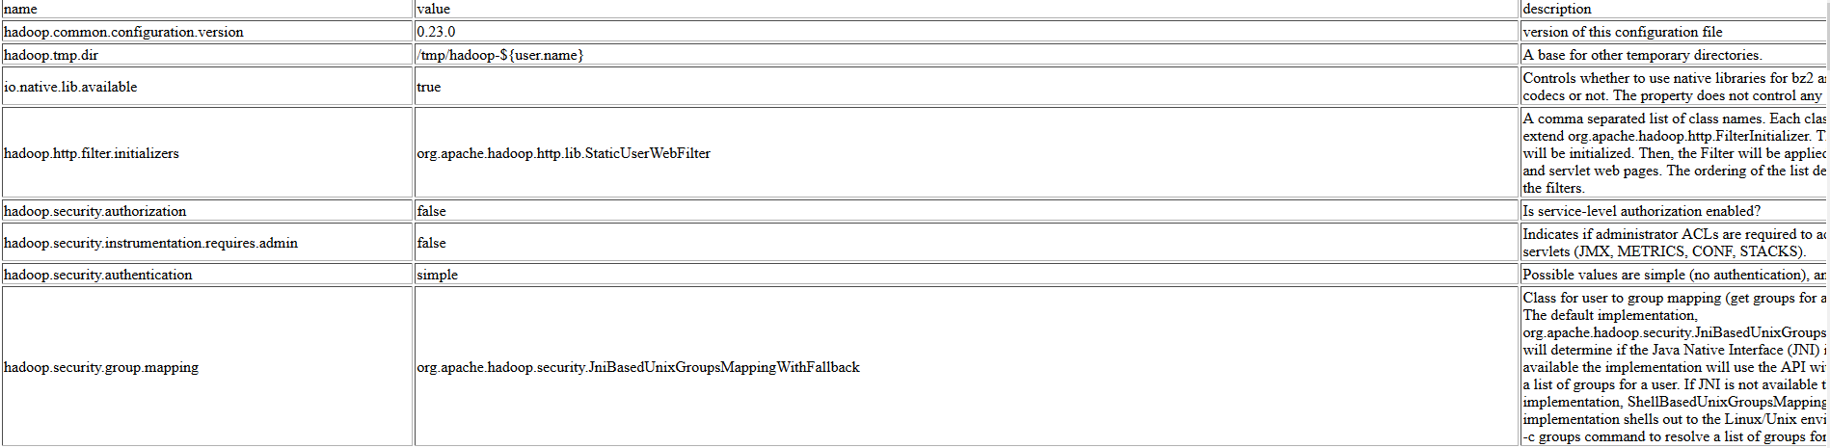
https://hadoop.apache.org/docs/r2.7.2/hadoop-project-dist/hadoop-common/core-default.xml

Slide 35
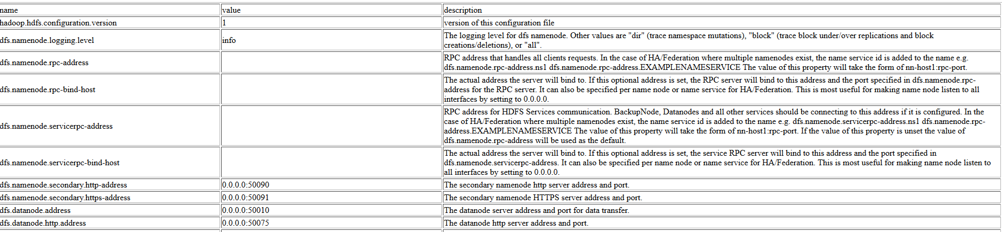
Hdfs-site.xml
https://hadoop.apache.org/docs/r2.4.1/hadoop-project-dist/hadoop-hdfs/hdfs-default.xml
Its impossible to talk about all properties. We are going to talk about few of them which are important

Slide 36
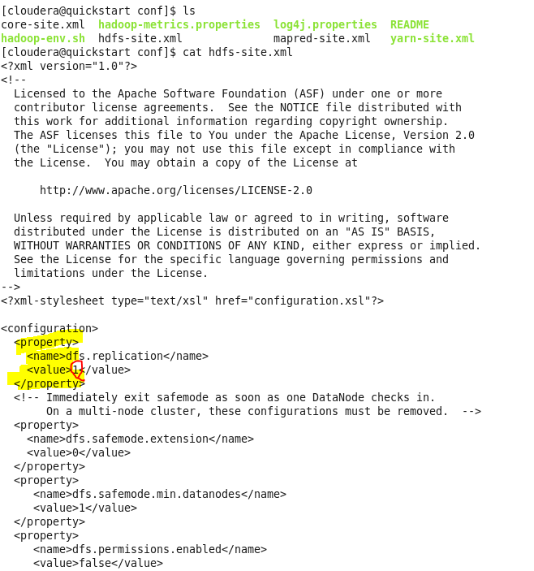
You see that as we are using one machine we see value for replication property is set to 1

Slide 37
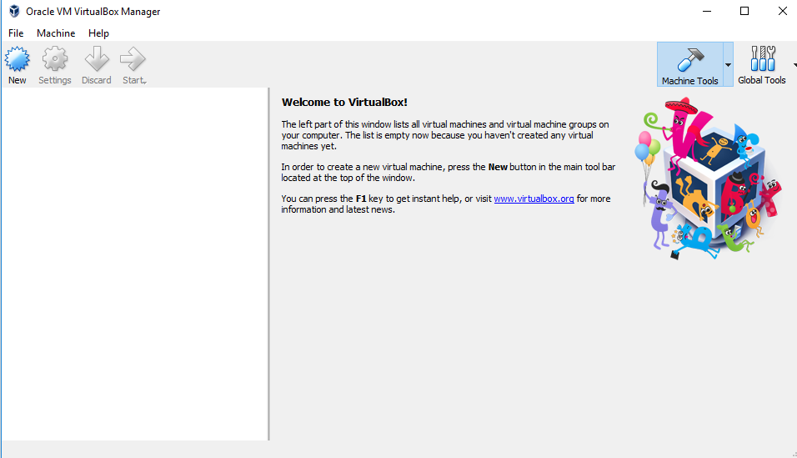
https://www.virtualbox.org/wiki/Downloads

Slide 38
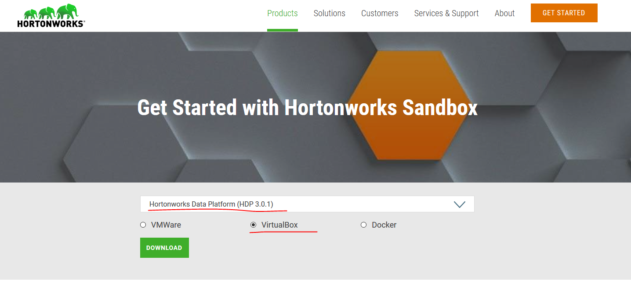

Slide 39
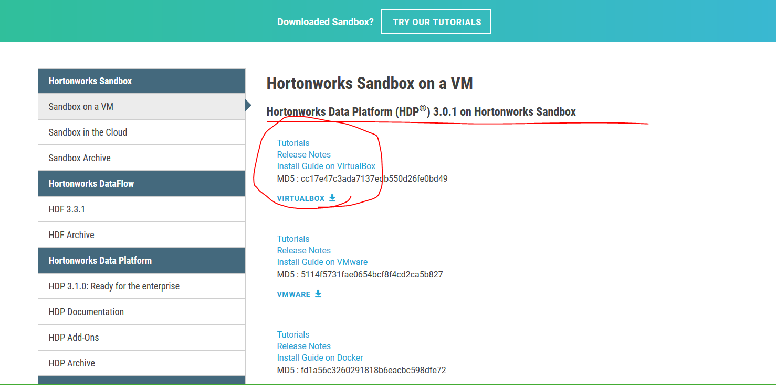
Notes:
https://hortonworks.com/products/sandbox/?utm_source=google&utm_medium=cpc&utm_campaign=hw_sandbox&utm_content=rlsa&gclid=EAIaIQobChMIyYjX64L63wIVpB-tBh0HGQKREAAYASAAEgIzFfD_BwE

Slide 40
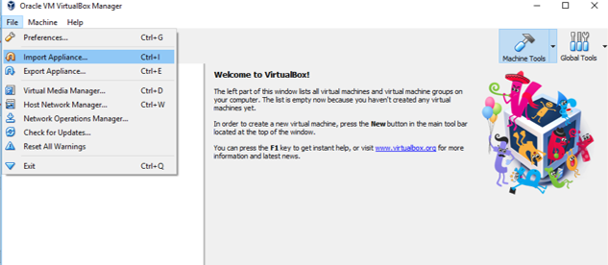

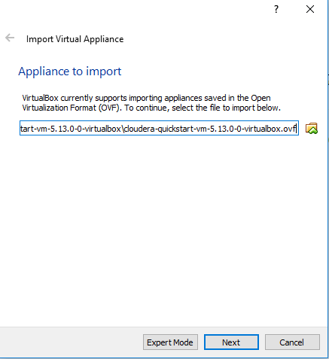

Slide 41
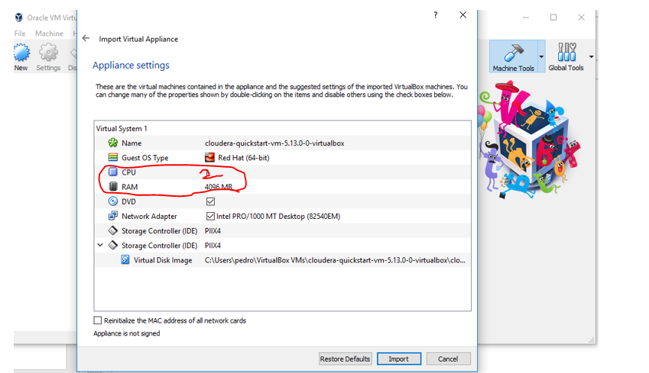
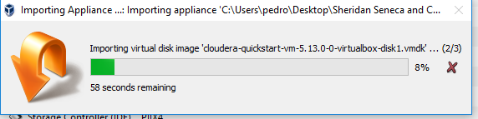

Slide 42
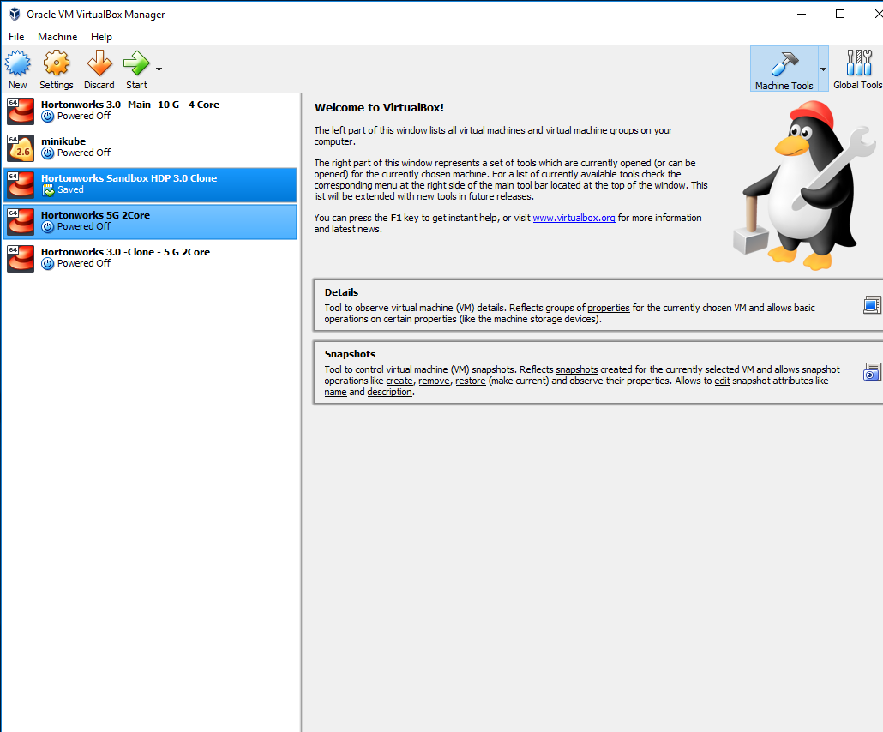

Slide 43
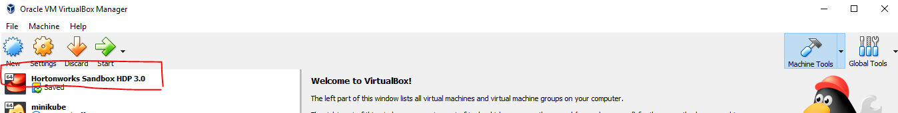

Slide 44
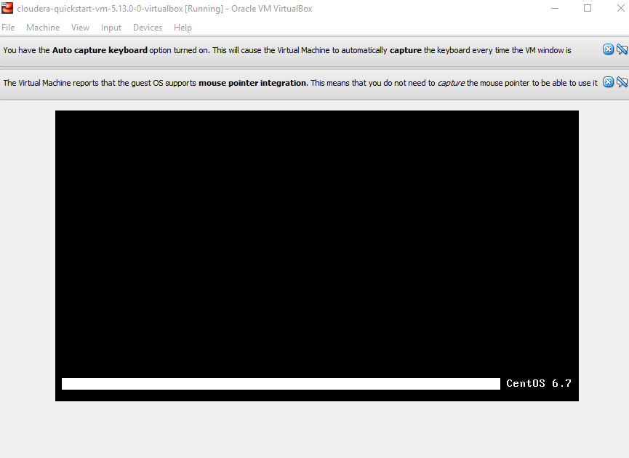

Slide 45
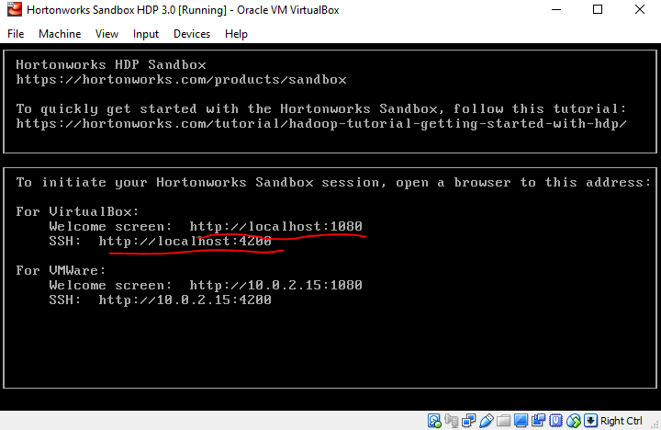

Slide 46

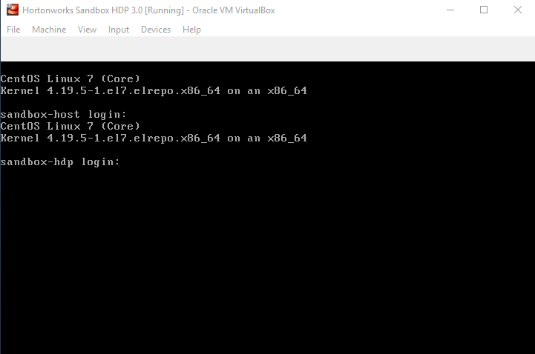
ALT+F5

Slide 47
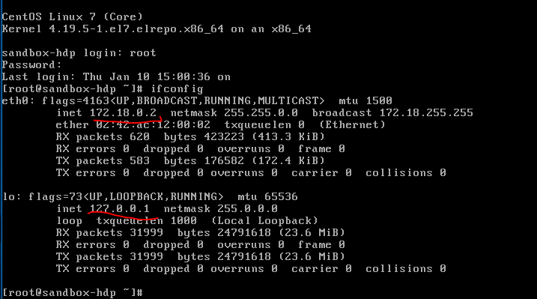
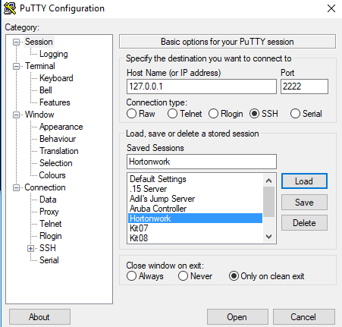

Slide 48
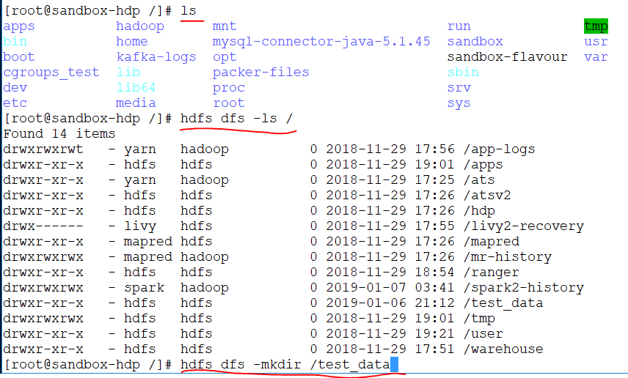

Slide 49
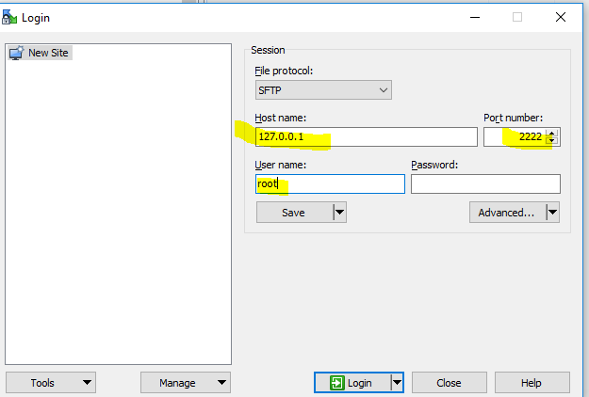
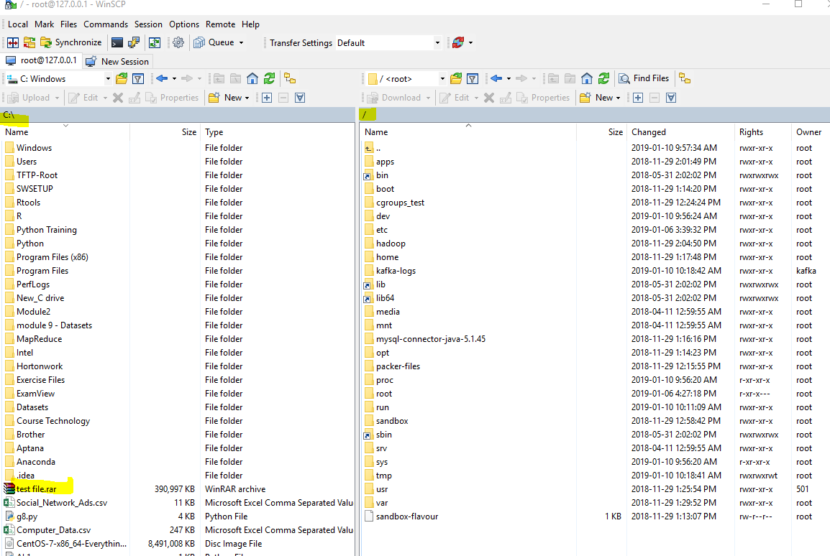

Slide 50
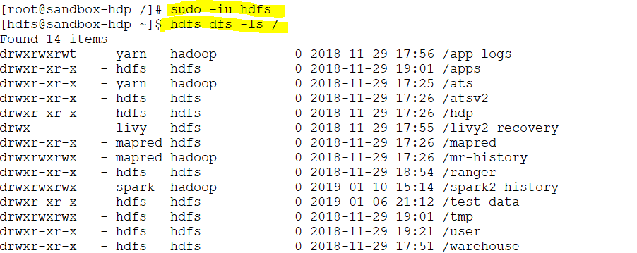
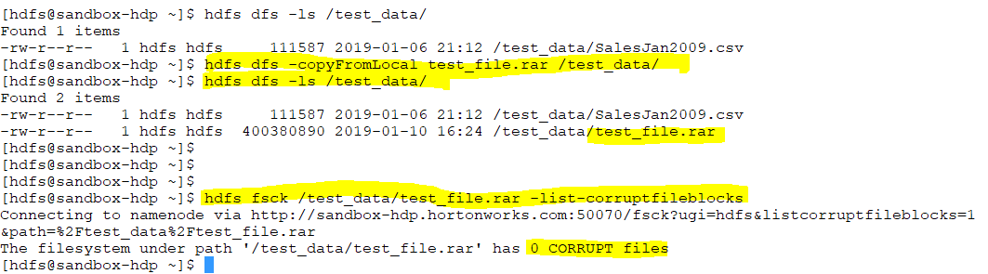
Notes:
https://hadoop.apache.org/docs/r2.4.1/hadoop-project-dist/hadoop-common/FileSystemShell.html
https://hadoop.apache.org/docs/r2.4.1/hadoop-project-dist/hadoop-common/FileSystemShell.html

Slide 51
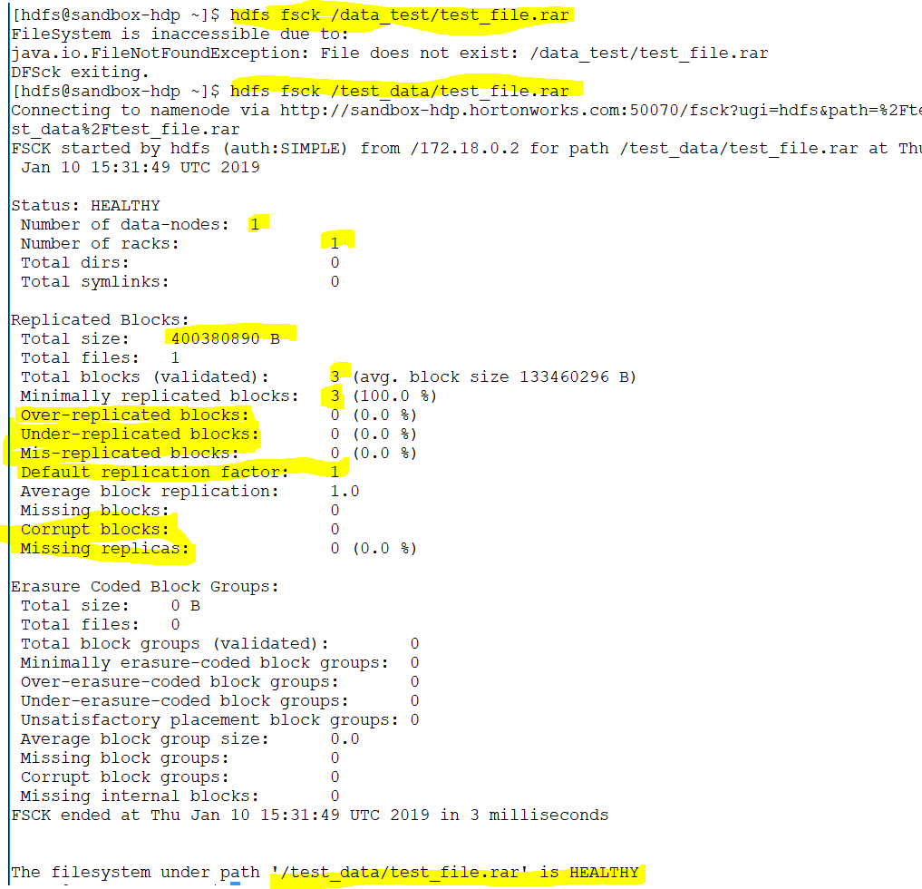
Notes:
All the information in the file in file system
In HDFS only the name node knows that there is a file and these are the block s of the files.no one else knows these blocks are pointing to a file.
The file size is 390 but in the command line shows 400 MB .It shows more

Slide 52
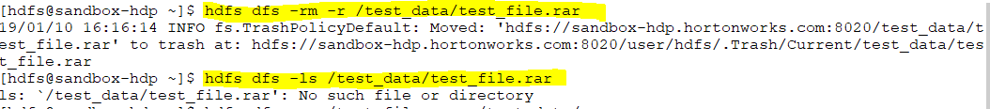
Notes:
Practice https://hadoop.apache.org/docs/r2.7.1/hadoop-project-dist/hadoop-common/FileSystemShell.html#appendToFile

Slide 53
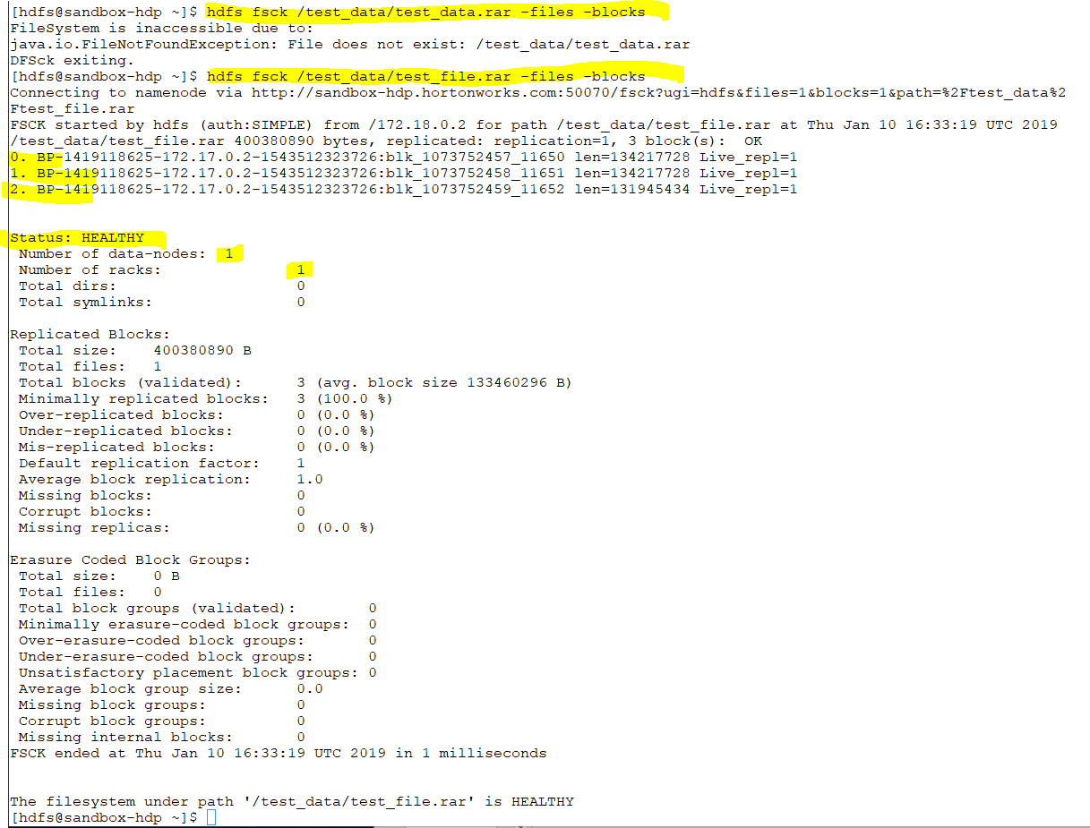
Notes:
Print out the block report
Its kind of summary
Fsck for developer
Dhfs for administrator

Slide 54
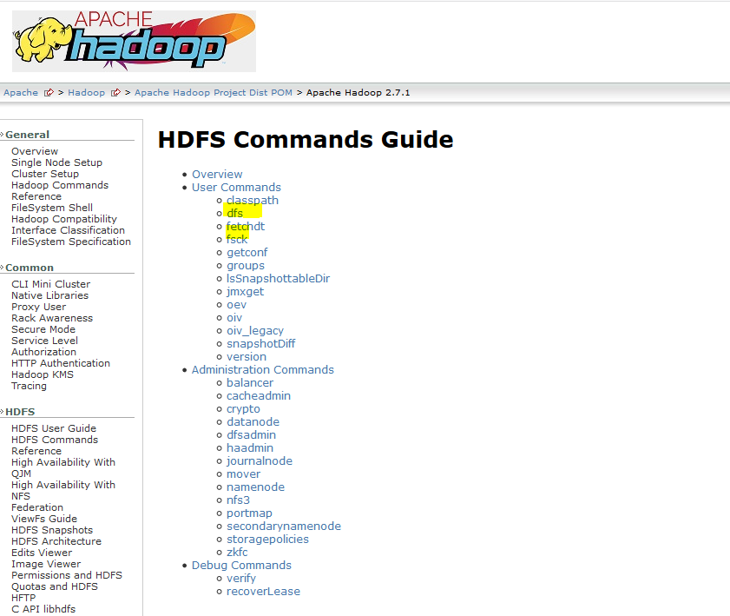
Notes:
HDFS command give us an ability to walk through the file
Fsck give us an ability to look into the actual file system .If we want to go to the actual block we use fsck

Slide 55
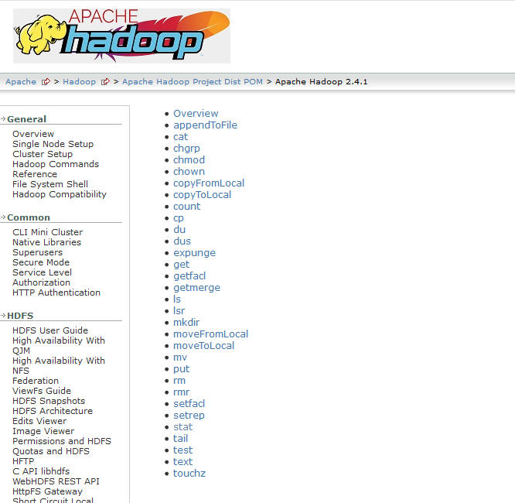
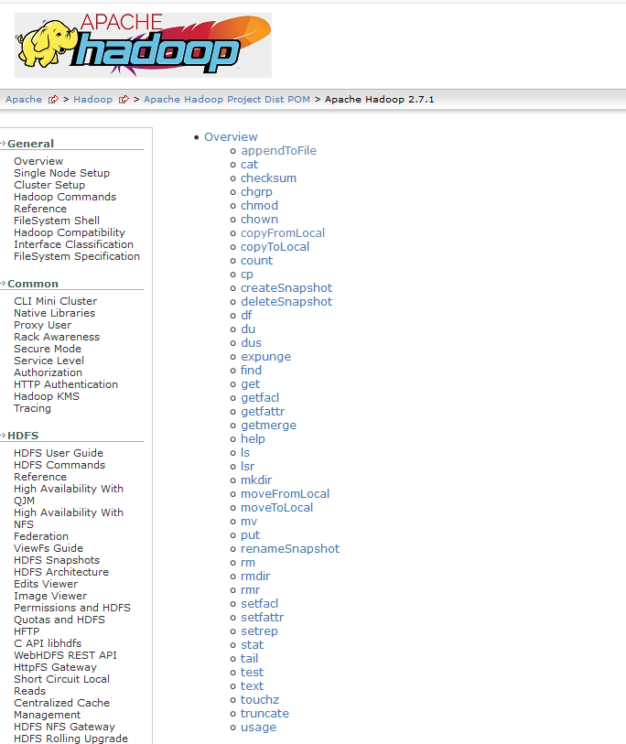
Notes:
https://hadoop.apache.org/docs/r2.4.1/hadoop-project-dist/hadoop-common/FileSystemShell.html
https://hadoop.apache.org/docs/r2.7.1/hadoop-project-dist/hadoop-common/FileSystemShell.html#appendToFile

